Slide 1
Lab #1
Exploring the Linux kernel
NEU – 2017

Slide 2
Goals
Familiarization with Linux
Extend your comfort zone
Understanding kernel functionality
Appreciation of kernel complexity

Slide 3
WARNING
You can mess up a perfectly good install!
Safety Steps
VirtualBox install
Clean Machine
Separate Hard Drive
Proceed at your own risk!

Slide 4

VMware/VirtualBox
Create a sandbox environment
Host OS (Windows/OS X)
Guest OS (Linux)
Altering Guest OS does not impact Host OS

Slide 5
Physical Installation
Optional – use a spare HD
Only HD plugged in, only HD altered
Risky – use an existing environment
Attempt a dual-boot
DO AT YOUR OWN RISK ☹
Do NOT attempt a physical installation on university owned equipment (that is not under your complete control)

Slide 6
General Steps
Obtain/Configure installation environment
VirtualBox
Install a Linux distribution
OSC Virtual Machine
LAB
Add a simple user-created kernel module
Configure and recompile the kernel

Slide 7
Prepare your Linux Distribution
Ensure proper packages are available
From a terminal, execute the following command
sudo apt-get install gcc make binutils libncurses5-dev
This will likely ask you for your password (which is osc on the OS virtual machine)

Slide 8
Initial Task – Adding a module
The Linux Kernel can be modified with additional modules
Modularity adds flexibility
Sacrifices some efficiency (modules have to be loaded/unloaded from memory as needed)
Begin with the Linux Kernel Modules programming project “Part I” on Page 96

Slide 9
Source & Compiling
Examine the book’s source code discussion
Examine the source code via the virtual machine (desktop, chapter 2)
Q1) What files are created (and what do they do)?

Slide 10
Install & Confirm
Is the kernel module compiled?
Did install complete?
How can you tell?
Was uninstall/removal successful?
How can you tell?
MOST tweaking will happen WITHOUT user created modules…

Slide 11
Kernel or Module …
NOTE: Code in the Linux kernel can be put in the kernel itself or made as a module. For instance, users can add Bluetooth drivers as a module (separate from the kernel), add to the kernel itself, or not add at all. When code is added to the kernel itself, the kernel requires more RAM space and boot-up time may take longer. However, the kernel will perform better. If code is added as modules, the code will remain on the hard-drive until the code is needed. Then, the module is loaded to RAM. This will reduce the kernel's RAM usage and decrease boot time. However, the kernel's performance may suffer because the kernel and the modules will be spread throughout the RAM. The other choice is to not add some code. For illustration, a kernel developer may know that a system will never use Bluetooth devices. As a result, the drivers are not added to the kernel. This improves the kernel's performance. However, if users later need Bluetooth devices, they will need to install Bluetooth modules or update the whole kernel.
Notes:
http://www.linux.org/threads/the-linux-kernel-configuring-the-kernel-part-1.4274/

Slide 12
Kernel Installation Steps (run as root – sudo /bin/bash)
Download a kernel
cd /usr/src
wget https://cdn.kernel.org/pub/linux/kernel/v4.x/linux-4.6.tar.xz
tar xf linux-4.6.tar.xz
Understand your system components
lspci (-v), lsusb, lscpu, cat /proc/cpuinfo, cat /proc/meminfo
Configure the kernel
cd linux-4.6
make menuconfig
Notes:
To run individual commands as root use# sudo COMMAND
To shortcut running commands as root use# sudo xterm&
which will open a new terminal as the root user

Slide 13
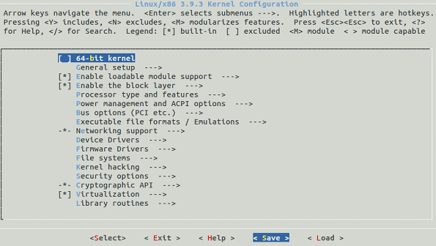
Explore ALL configuration options
Notes:
You may elect to disable or enable various options. For example, if you are running on a Pentium 4 you can disable AMD related components and select the specific processor. Every option should also have a “Help” screen to describe what that component does. When you’re finished in a sub-menu, Exit will return to the next highest menu level.

Slide 14
Configure for your hardware
Save configuration file to .config
# sudo make –j2
# sudo make modules
# sudo make modules_install install
# sudo reboot (#sudo shutdown –r now)
Check uname –r and lsb_release –a
Notes:
The –j2 option will utilize 2 concurrent threads when possible (match to the number of cores)

Slide 15
Write-up ¾ - 1 page
List 2-3 details about a kernel module
Initial kernel version
Installed kernel version
Identify a configuration component related to something we’ve discussed up to this point
Challenges encountered
Discussion of relevant kernel options
What did you enable – why?
What did you disable – why?
Open questions/thoughts
Notes:
Kernel version can be found using command# uname –r
OS version can be found using command# lsb_release –a

Slide 16
Summary
Install OSC VM
User and root passwords are OSC
Create, add, and remove the simple kernel module provided in the VM
Download, configure, install, (and confirm) a new kernel, such as Linux 4.6
Write up the summary & submit

